Slide 1
Business Outreach Initiative: Child Care for Working Families
“The green reed which bends in the wind
is stronger than the mighty oak which breaks in a storm.”

Slide 2
The Early Learning Hub (EL Hub) of Linn, Benton & Lincoln Counties brings together over 200 partners to increase family stability, improve kindergarten readiness, and ensure service coordination that is equitable as well as culturally and linguistically competent. The EL Hub looks to create a growing network within the three county business community in a mutually beneficial partnership to seek solutions to the current child care crisis. The objective of this presentation is to educate businesses and other employers about the child care crisis, to gather data from the business community about how the crisis is affecting them, and to solicit assistance from business leadership for solutions that can provide help to working parents and guardians.

Slide 3
Oregon’s Child Care Crisis
A “Child Care Desert” exists when there are at least 3x birth-to-five aged children or more for every available regulated child care slot in existing child care programs.
Currently, all 36 counties of Oregon are classified as “deserts,” some worse than others: ¹
Based on 2020 Census information of children aged birth to five with working parents, cross-referencing the number of regulated child care slots currently available as of mid-2022, the three counties suffer from the following shortfalls: ²
Percent of children with potential access to a regulated child care slot, by age
County | 0-2 year old | 3-5 year old | Total children <6 years old
Linn | 7% | 19% | 13%
Benton | 21% | 45% | 33%
Lincoln | 4% | 29% | 16 %
County | Regulated Child Care Slot Shortfall
Linn | 3,773
Benton | 850
Lincoln | 775

Slide 4
Impact of the Child Care Crisis on Working Families
Prohibitive
child care costs
Lack of availability of
child care programs

Slide 5
Prohibitive Child Care Costs
In Oregon, the standard cost for base-quality child care is $13,000 per year, per child. ³
In comparison, the average annual tuition/fees for a four-year public university in Oregon is $8,140. ⁴
In May 2022, it was reported by the US Bureau of Labor Statistics that the average Oregon salary was $$62,680. ⁵
Nationwide, 60% of child care is paid for by families, 39% by govt, but only 1% by philanthropy. ⁶
Oregon families fund 72% of child care costs. ⁷
“4 in 5 working parents say it's important that the business community leads the way when it comes to providing access to quality and affordable child care.” ⁸

Slide 6
Lack of Availability
If there is such a high demand for child care, then why can’t supply meet the demand?
For the most part, the for-profit child care industry utilizes a business model where the rising operating costs can’t be placed on the consumer because it is already prohibitively expensive. Nor are there any simple means to cut operating costs (though we’re working on fixing this).
So many child care providers are stuck using a business model with razor-thin profit margins.
This also acts as a deterrent for those contemplating careers in child care (though we are working on fixing this as well) and causes the closures of existing programs to fail after only a few unprofitable months.

Slide 7
Compensation Comparison
(Oregon minimum wage 2023: $14.20)
Title | Position | Min. Age | Education | Accreditation | Experience | Avg Wage/Salary
Certified Child Care Center | Director | 21 | Assoc Degree (AA) | None | 1 year of management/ supervision of adults | $49,500-62,500/yr
Certified Child Care Center | Head Teacher | 18 | AA or BA | 20-30 credit hours/ 10 credits in ECE | 1 year teaching experience | $37,400/yr ($18/hr)
Certified Child Care Center | Teacher | 18 | AA or BA | 20-30 credit hours/ 10 credits in ECE | 6 months teaching | $33,900/yr ($16.30/hr)
Certified Child Care Center | Teacher’s Aid | 15-18 | N/A | 2 hours of ECE training | Up to 4 months | $29-33,000/yr ($14-16/hr)
Lebanon Police Dept | Sworn LEO | 21 | High School Degree | Graduate police academy | None | $49-62,000/Yr
Greater Albany Public Schools | Kindergarten teacher | 21 | BA | Teaching certification | 4 months student teaching | $48-$70,00/Yr
Red Robin Gourmet Burgers, Albany | Cook | 17 | None | None | None | $33k/yr ($16/hr) + sharing tips
Target Distribution Center, Albany | Warehouse Worker | 18 | None | None | None | $21.25/hr

Slide 8
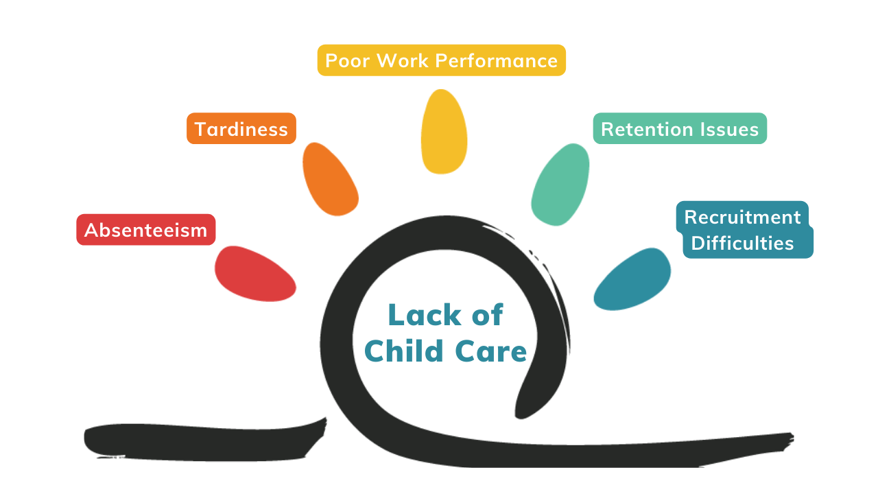
The Effects of the Child Care Crisis on the Business Community

Slide 9
This Pain is Nationwide
"U.S. businesses lose $3 billion annually due to employee absenteeism as the result of child care breakdowns.“ ⁹
"During a three-month period, 29% of employed parents experienced some kind of child care breakdown, resulting in absenteeism, tardiness, and reduced concentration at work.“ ¹⁰
“In each year from 2016 to 2018, more than 2 million parents of children age 5 and younger, 9%, or nearly 1 in 10 parents, had to quit a job, not take a job, or greatly change their job because of child care problems.” ¹¹

Slide 10
Child Care Solution Options
Fast, Cheap, and Easy Ways: Resource referral, Dependent Care FSA, flexible scheduling, and predictable scheduling
Subsidizing: Addressing cost, employers can help their employees pay for child care
Employer-Sponsored Child Care: Addressing the lack of availability for their employees, employers can create more child care programs from scratch, including on-site certified child care centers, or partner with existing child care programs to contract slots using Priority Access-Priority Waitlist
Philanthropy: Using charitable funding to tackle the root cause problems that must be solved: child care workforce incentivization, subsidizing business development, and increasing the education pipeline

Slide 11
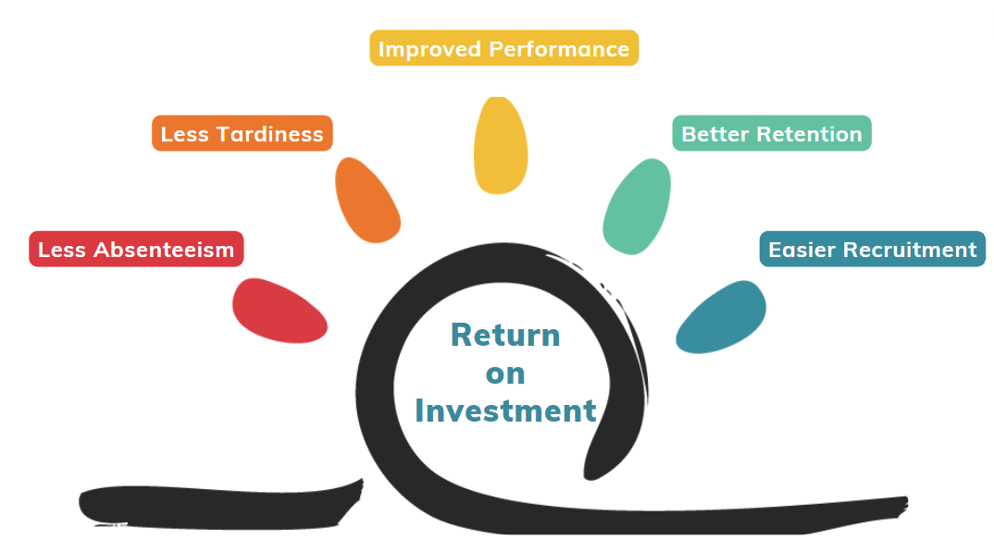
Assisting Employees With Child Care: The Five Negative Effects Turn into the Returns on Investment

Slide 12
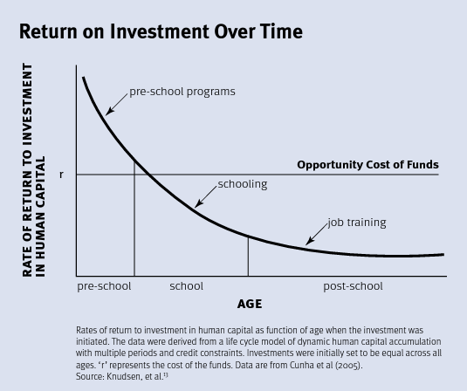
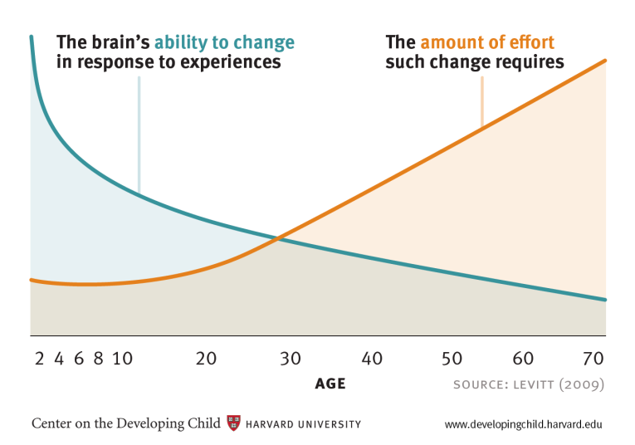
The Biological ROI: Child Brain Development

Slide 13
Questions/Comments/Concerns?
Bryan Steinhauser, Business Liaison
The Early Learning Hub of Linn, Benton & Lincoln Counties
Linn Benton Community College 6500 Pacific Blvd SW, LM-132 Albany OR 97321
(541) 917-4914
steinhb@linnbenton.edu

Slide 14
Sources
1. “2020 Oregon's Childcare Deserts,” Oregon Child Care Research Partnership, OSU, 2020
2. ACS 5-Years Estimates from 2020 (Tables B23008, C16002), Office of Child Care, June 29, 2022, Oregon Cascades West Council of Governments, Geographic Information Systems
3. “The True Cost of High-Quality Child Care Across the United States,” Jun 2021, Center for American Progress
4. “2023 Tuition Comparison Between Oregon Colleges,” accessed June 23, 2023, www.collegetuitioncompare.com
5. Bureau of Labor Statistics website
6. “Financing Child Care in the United States,” Mitchell, Stoney, & Dichter, 2001
7. “OSU presentation to the Oregon Legislature,” M. Pratt, Feb 2019
8. 2018 U.S. Chamber of Commerce Foundation survey on child care, April 2018
9. “Child Care & Parent Productivity: Making the Business Case,” Shellenback, K. 2004
10. “2008 National Study of Employers,” Bond, J.T., Galinsky, E., & Sakai, K. 2008
11. “2020 National Survey of Children's Health,” Health Resources and Services Administration’s
Maternal and Child Health Bureau, 2020

