Slide 1
Executive Summary
Regional
Databook
2023 Edition

Slide 2
Economic & Social Factors
. . . . . . . . . . . . . . . . . . . . . . . . . . . 2
The poverty line • Parental Employment • Rural Populations • Housing • Food Insecurity
Wellbeing
. . . . . . . . . . . . . . . . . . . . . . . . . . . . . . . . . . . . . . . . . . . . . 10
Immunization • Health Insurance • Oregon Student Health Survey • Child Abuse
Child Care
. . . . . . . . . . . . . . . . . . . . . . . . . . . . . . . . . . . . . . . . . . . . 15
Availability • Affordability • Teacher Salary • Preschool Enrollment

Slide 3
Economic &
Social Factors
2023 Regional Databook Executive Summary

Slide 4
27.8%
of children under six years old live under 100% Federal Poverty Level in Lincoln County (479)
16.5% (1,466) in Linn County 14.8% (932) in Benton County
4 | Lincoln County

Slide 5
57.4%
of children under six years old live under 200% Federal Poverty Level in Lincoln County (1,156)
46.6% (3,539) in Linn County 29.1% (2,249) in Benton County
5 | Lincoln County

Slide 6
77.5%
of single mothers with young children in Benton County live in poverty
65% in Lincoln County 45.6% in Linn County 39.2% statewide
6 | Benton County

Slide 7
Families with young children (under six years) have lower percentages of all available parents in the labor force than families with older children (6 to 17 years).
Linn County has the highest percentage of families with children under six years where all parents are in the labor force (62.2%)
Benton County (61.8%) Lincoln County (61.7%)
7 | Linn County

Slide 8
Rural communities face more disparities, including higher poverty, unemployment, lack of transportation, limited access to healthcare, lower education levels, and reduced access to quality child care and education.
Benton County has the highest percentage of young children living in rural areas (35.6%)
Lincoln County (32.7%) Linn County (15.9%)
8 | Benton County

Slide 9
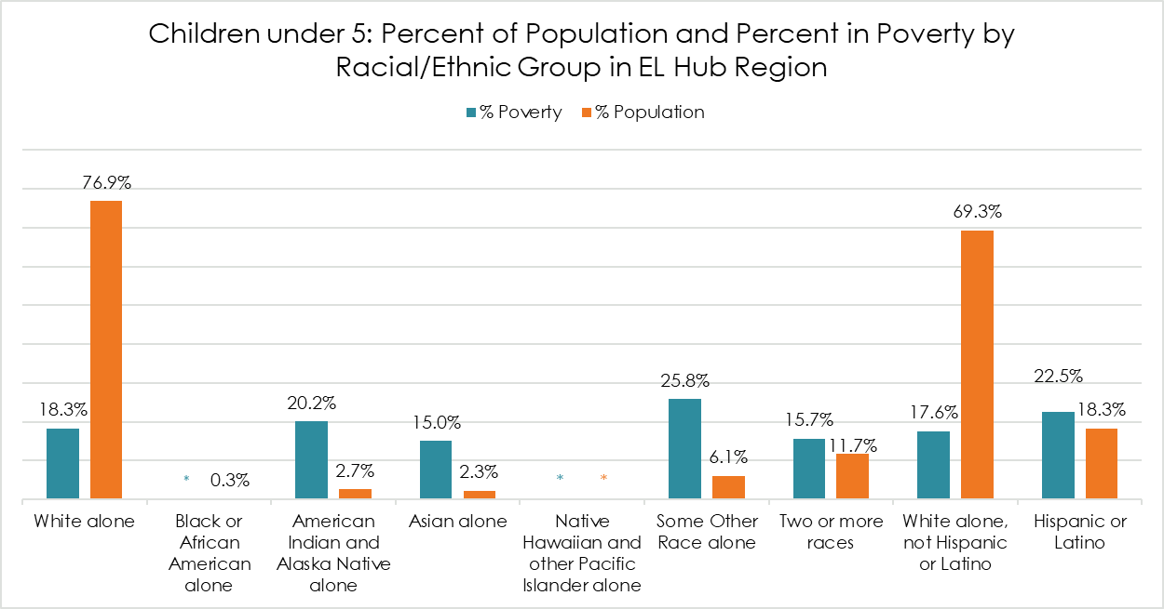

Slide 10
More than 1 in 10 students in Lincoln County lack stable housing. Lincoln County has the highest percentage of students lacking stable housing in our region in the past four years. (12.1%)
Linn County has the highest number of students experiencing homelessness in our region. (993)
10 | Lincoln County

Slide 11
Children living in food-insecure households have limited or uncertain availability of nutritionally adequate food.
Lincoln County has the highest percentage of children in food-insecure households (24.4%)
Linn County (18.5%)
Benton County (13.4%)
Statewide level (15.4%)
11 | Lincoln County

Slide 12
Wellbeing
2023 Regional Databook Executive Summary

Slide 13
Two-year-old immunization rates have improved in our region but are still lower than the statewide rate (71%).
Linn County had the highest immunization rate in 2021 (70%)
Benton County (61.8%) Lincoln County (61.7%)
13 | Linn County

Slide 14
Percentage of young children (under 6 years) without health insurance: Linn County 8.2% Lincoln County 5.2% Statewide Rate 2.9% Benton County 1.4%
14 | Linn County

Slide 15
The 2020 Oregon Student Health Survey found that children and youths in our region are struggling with issues such as obesity, adverse childhood experiences, social and emotional health, and substance use. It is important for families, schools, and communities to work together to provide support for these children and help them develop healthy coping skills.
15 | Statewide

Slide 16
In 2021, Linn County recorded the highest number of child abuse incidents at 663. Notably, threats of harm and neglect were the most common factors contributing to these incidents.
Benton County (253) Lincoln County (163)
16 | Linn County

Slide 17
Child Care
2023 Regional Databook Executive Summary

Slide 18
Our region is considered a “child care desert” where access to regulated child care is limited for all children, with the greatest need for child care slots for children ages 0 to 2 years. There are very few public slots from Regulated Programs for children 0 to 2 years in our region, with Lincoln County having no slots at all.
18 | Lincoln County

Slide 19
The median annual cost of toddler care in a child care center: $14,828 in Benton County (60% of a full-time job pay with the minimum wage)
$9,420 in Linn County
(39% of a full-time job pay with the minimum wage) $7,320 in Lincoln County (30% of a full-time job pay with the minimum wage)
19 | Benton County

Slide 20
Early child care teachers could be paid less than a full-time job with minimum wage ($28,080)
The range of annual median early childcare teacher salary is:
$25,480 - $31,762 in Linn County
$25,480 - $34,320 in Benton County
$24,419 - $45,750 in Lincoln County
20 | Statewide

Slide 21
The preschool enrollment rate in Linn County is much lower than the statewide rate. (42.2%)
Linn County 21.8% (662 out of 3,042 children aged 3 to 4 years)
Benton County 43.5% (592 out of 1,360)
Lincoln County 44.2% (356 out of 810)
21 | Linn County

Slide 22
Of the children enrolled in preschool, the percentages in public preschool: 53% in Linn County 46.6% in Benton County 80.6% in Lincoln County
Benton County has the lowest percentage of public slots for children 3 to 5 years from Regulated Programs in our region (11%) followed by Linn County (28%)
22 | Lincoln County

Slide 23
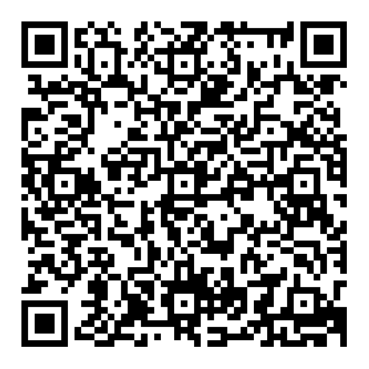
Scan to view the full
2023 Regional Data Book

